Slide 1
Smart Time Table Generator Using Django
Team Details:
Anireddy Saikiran Reddy(21EG505802)
S.Venkatesh(21EG505863)
P.Nikhil(21EG505856)
Project Supervisor
Name: Ms. A.Durga Bhavani
Designation: Assistant Professor

Slide 2
Introduction
Timetabling is one of the common scheduling problems, which can be described as the allocation of resources for tasks under predefined constraints so that it maximizes the possibility of allocation or minimizes the violation of constraints. Due to the non-proportionality between a rapid increase in the number of students enrolled, university courses and accessible resources, the complexity of the problem has become multifold.

Slide 3
Literature
Author(s) | Method | Advantages | Disadvantages
Dipti Srinivasan , Tian Hou Seow , Jian Xin Xu | C++ using evolutionary algorithm | There is no fixed crossover rate in this algorithm. | The crossover operation stops when an additional N offsprings are generated
Pushkara Sharma,Pankaj Hans and Subhash Chand Gupta | Artificial Neural Networks and hybrid approach | Students , Faculties can Modify the Timetable. | which made deployment harder.
Subhajit Maity, Sujan Sarkar, A vinaba Tapadar, Ayan Dutta, Sanket Biswas, Sayon Nayek, and Pritam Saha | Angular JS, Bootstrap Approach | This algorithm uses Angular,js Bootstrap | It is occuring Time Clashes and subject name clashes

Slide 4
Literature
Author(s) | Method | Advantages | Disadvantages
Mark Yeo Soon Hock, and Edmond C. Prakash | Software Engineering Techniques | Less number of data preparation steps and highly versatile algorithm | Deployment is Harder as Compared to others.
Mrunmayee V. Rane,Vikram M. Apte, Vishakha N. Nerkar | Django-Python | We will get accurate results by the applying security

Slide 5
Problem Statement
Timetabling is the complex task of assigning resources to tasks under constraints, commonly seen in universities with mismatched student numbers, courses, and resources. The challenge involves optimizing schedules to maximize resource use while minimizing constraint violations. This problem's intricacy arises from the non-proportional growth of students and resources. Solutions require algorithms and heuristics to balance student needs, resource availability, and institutional objectives effectively.
Objective
Our objectives encompass a comprehensive approach to addressing Parkinson's disease in India. Firstly, we aim to establish early detection and diagnosis programs, facilitating timely treatment. Secondly, we emphasize holistic care to manage both motor and non-motor symptoms, enhancing patients' overall well-being.Lastly, we strive for equitable access to specialized medical care and therapies, especially in underserved regions, ensuring support for all affected by the condition.

Slide 6
Proposed Method
Data Management: Utilize Django's powerful database management capabilities to store and manage course, instructor, room, and constraint data efficiently.
Algorithm Integration: Incorporate scheduling algorithms or heuristics (e.g., genetic algorithms, simulated annealing) into Django to automate timetable generation while considering resource allocation and constraint satisfaction.
User Preferences: Implement user interfaces to gather student preferences, instructor availability, and other scheduling constraints to improve satisfaction and adherence to requirements.
Constraint Validation: Develop modules within Django that validate and enforce constraints such as avoiding class conflicts, meeting room capacities, and accommodating instructor availability.

Slide 7
Proposed Method
Visualization: Create interactive timetable visualization using Django's frontend capabilities to provide a user-friendly overview of schedules, aiding stakeholders in understanding and reviewing generated timetables.
Automated Updates: Integrate automatic scheduling updates that account for changes in student enrollment, instructor availability, or other dynamic factors.
Optimization Trade-offs: Design components to evaluate and balance optimization trade-offs, enabling the system to generate schedules that align with institutional goals and student needs.
Scalability: Design the system to handle increasing complexity as the institution grows, ensuring it can accommodate a larger number of courses, students, and resources.

Slide 8
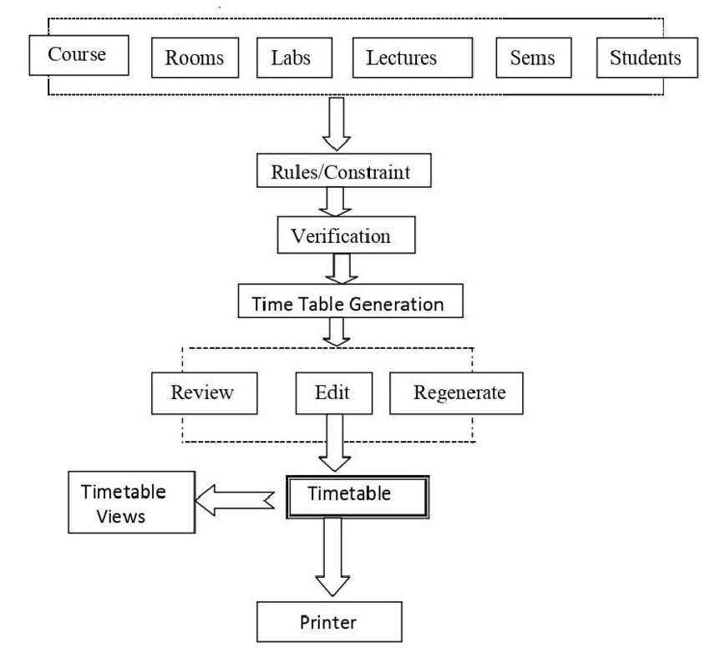

Slide 9
Project status
S. No | Functionality | Status (Completed /in-progress/Not started)
1 | Creation Of homepage | Completed
2 | Collection of College data | Completed
3 | Adding Security | In progress
4 | Some Extra Features | In progress
Note: Submit Form 1,2 and 3

Slide 10
References
Autonomous Timetable System Using Genetic Algorithm https://ieeexplore.ieee.org/document/9716370
Automated Timetabling System for University Course https://ieeexplore.ieee.org/document/9396906
Automated Time Table Generation Using Multiple Context Reasoning for University Modules https://ieeexplore.ieee.org/document/1004507
Software Engineering Approach For A Timetable Generator https://ieeexplore.ieee.org/document/892240
Time Table Generator Using Django https://ieeexplore.ieee.org/document/9396906

